Slide 1
JUnit 4 For Unit Testing

Slide 2


Unit Testing Introduction
- What is unit testing? - Test coverage
- Unit testing in Java
JUnit4 introduction
- Demo : JUnit4 Simple Example using Eclipse
- JUnit4 annotations
- Demo : JUnit4 annotations
- JUnit4 assertions

Slide 3
Demo : JUnit4 complete example using Eclipse
- Initial Steps
- Create the java class to be tested - Create and run a JUnit test case
- Using @Ignore annotation
- Creating Test Suites
- Creating parameterized tests
- Rules
- Collections and Arrays in JUnit Tests
- Run JUnit tests from command line

Slide 4
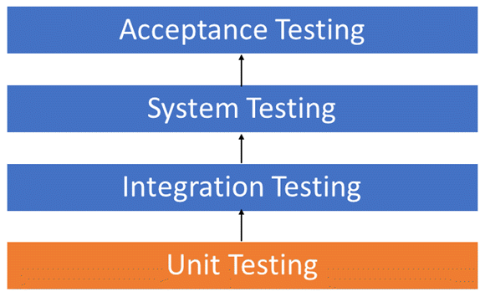
What is unit testing?

Slide 5

Test coverage
Test coverage is an important indicator in software testing in terms of quality and effectiveness.

Slide 6
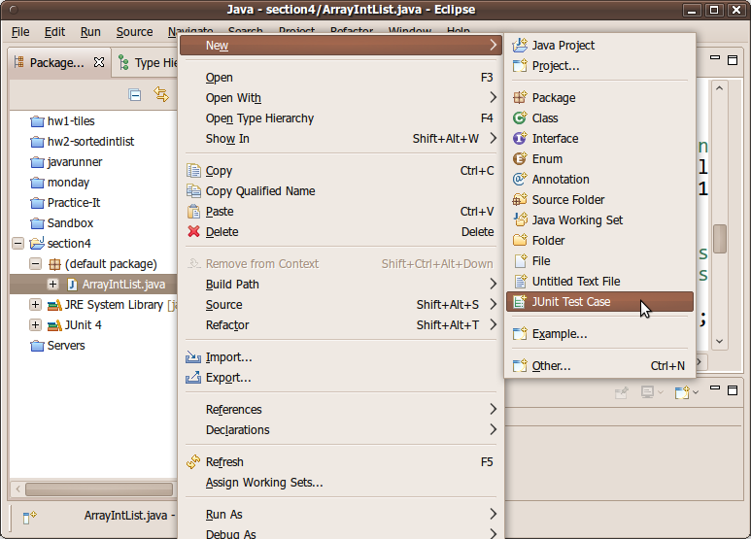
Unit testing in Java

Slide 7
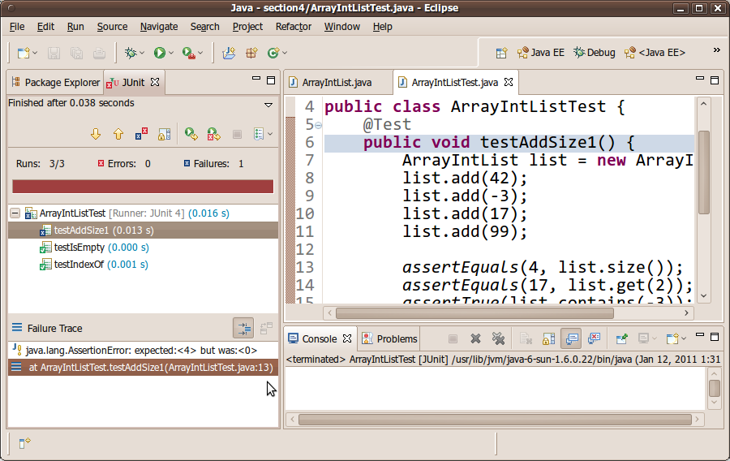
Unit testing in Java

Slide 8
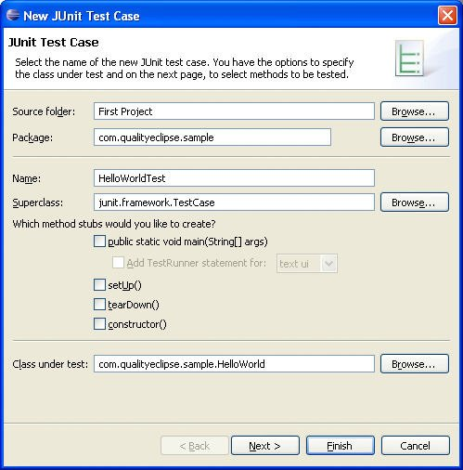
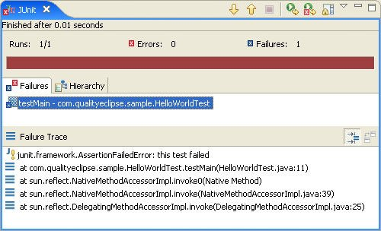
JUnit introduction

Slide 9


JUnit4 Simple Example using Eclipse

Slide 10
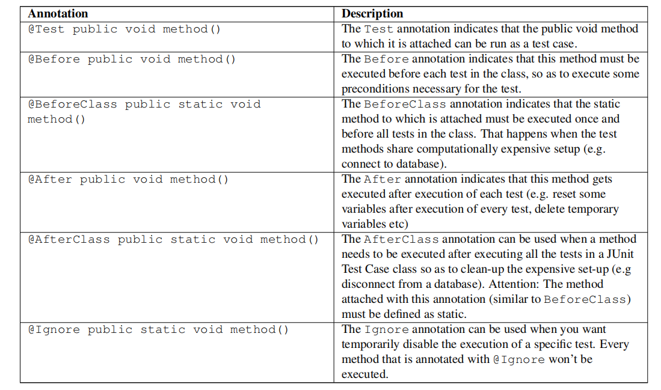
JUnit annotations

Slide 11
JUnit4 Annotations Example using Eclipse

Slide 12
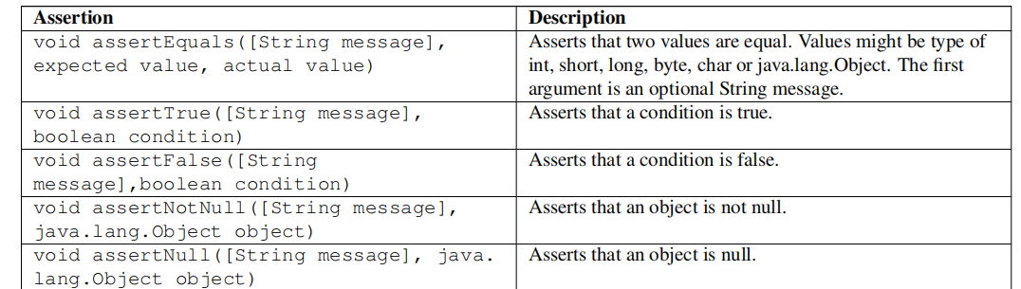
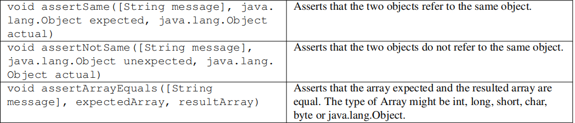
JUnit assertions

Slide 13
JUnit4 complete example using Eclipse

Slide 14
Using @Ignore annotation

Slide 15
Test Suites

Slide 16
What Is a Parameterized Test?
When it fullfills all the following requirements:
- The class is annotated with @RunWith(Parameterized.class).
- The class has a single constructor that stores the test data
- The class has a static method that generates and returns test data and is annotated with the @Parameters annotation.
- The class has a test, which obviously means that it needs a method annotated with the @Test annotation.

Slide 17
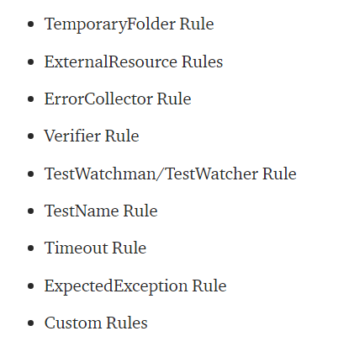
Rules

Slide 18
TestName Rule
TemporaryFolder Rule - How a JUnit Rule Works
ExpectedException Rule
Timeout Rule
Error Collector Rule
Creating a Custom JUnit Rule

